Slide 1
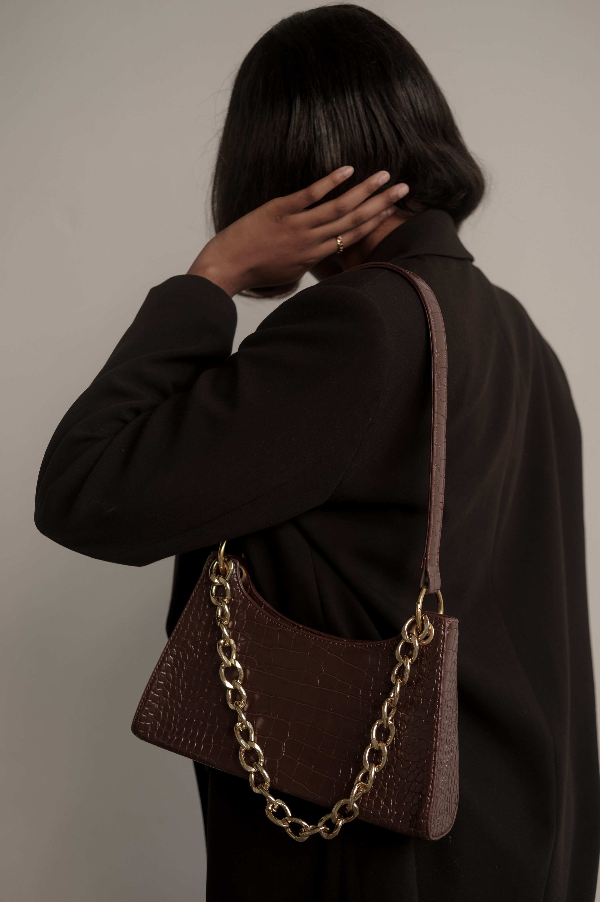
FITCHECK
VIRTUAL CLOSET SYSTEM BY
SEUNGAH CHOI

Slide 2

BUILT-IN PHP, CSS, MYSQL, AND XAMPP

Slide 3
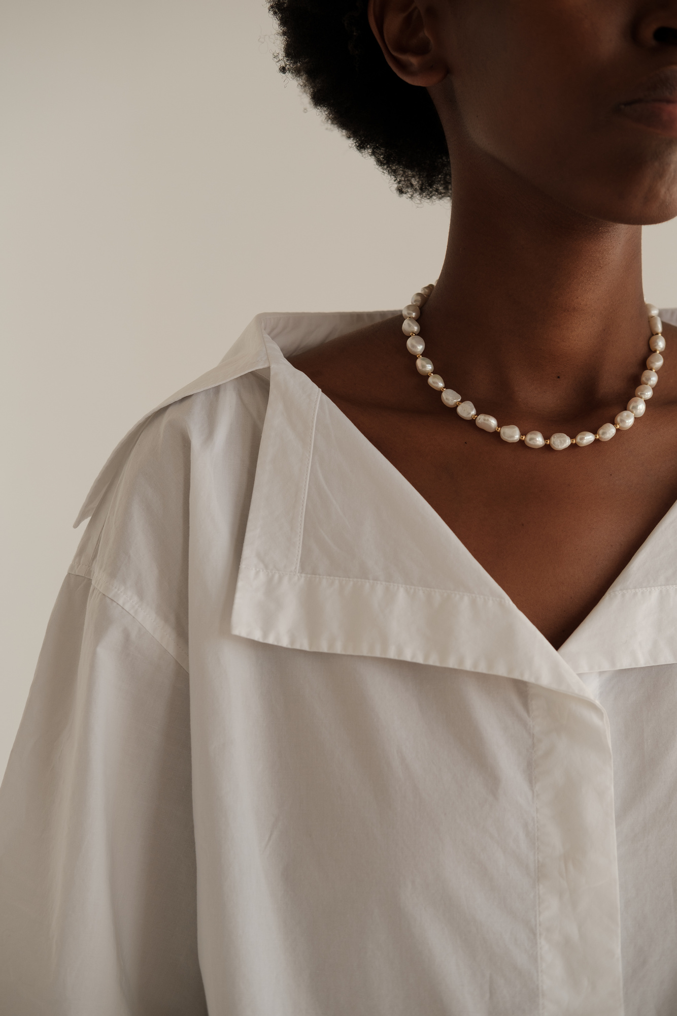
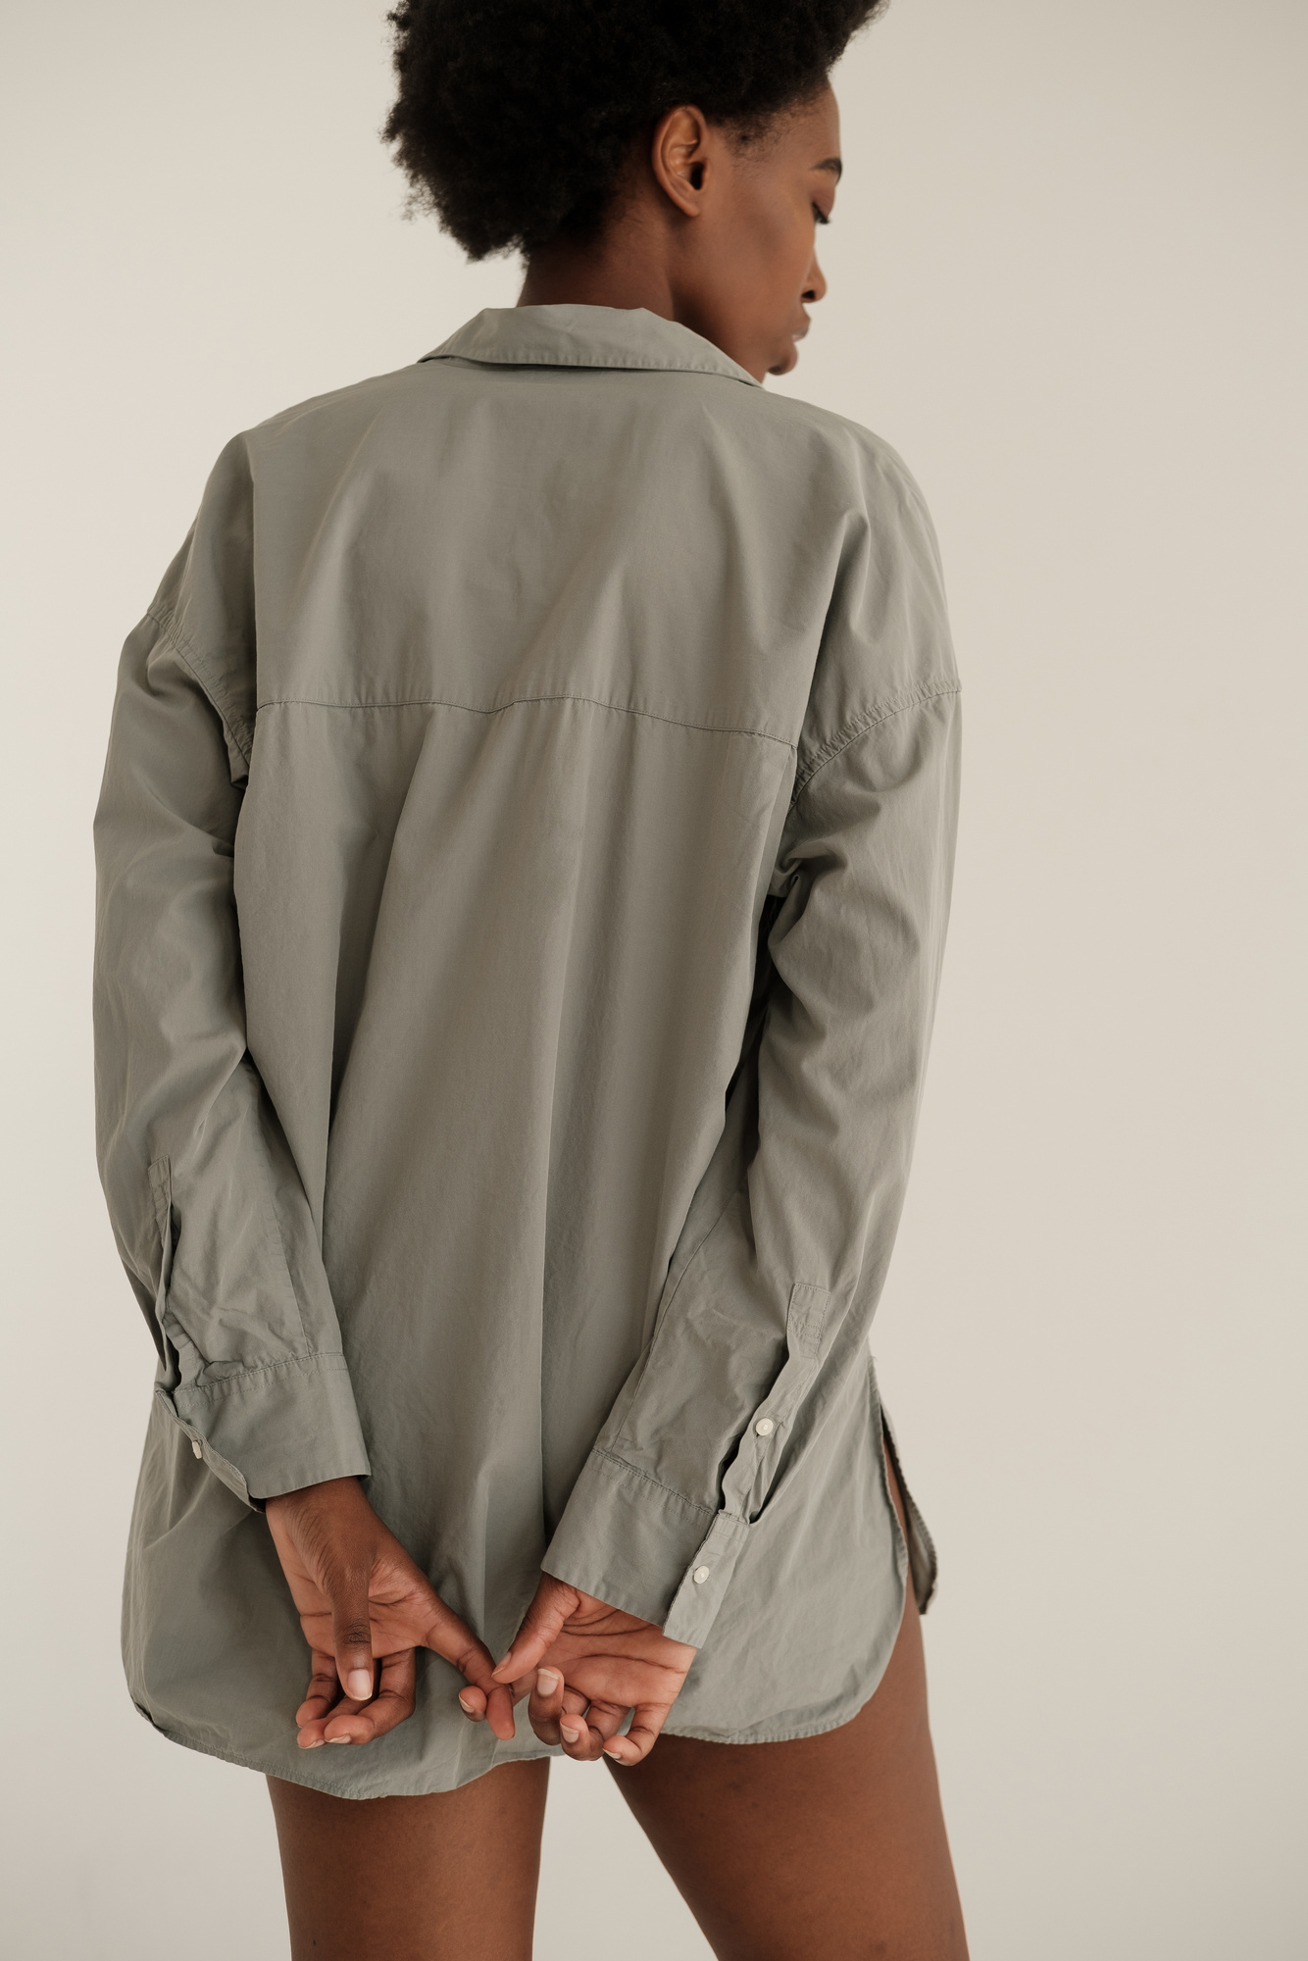

@sundaestroll (github)
ABOUT THE WEB APP
Sign-in and Sign-up page
Email and password validation through PHP
connected to the database
Add page
A form where a user uploads the png file of an item
Page 03

Slide 4
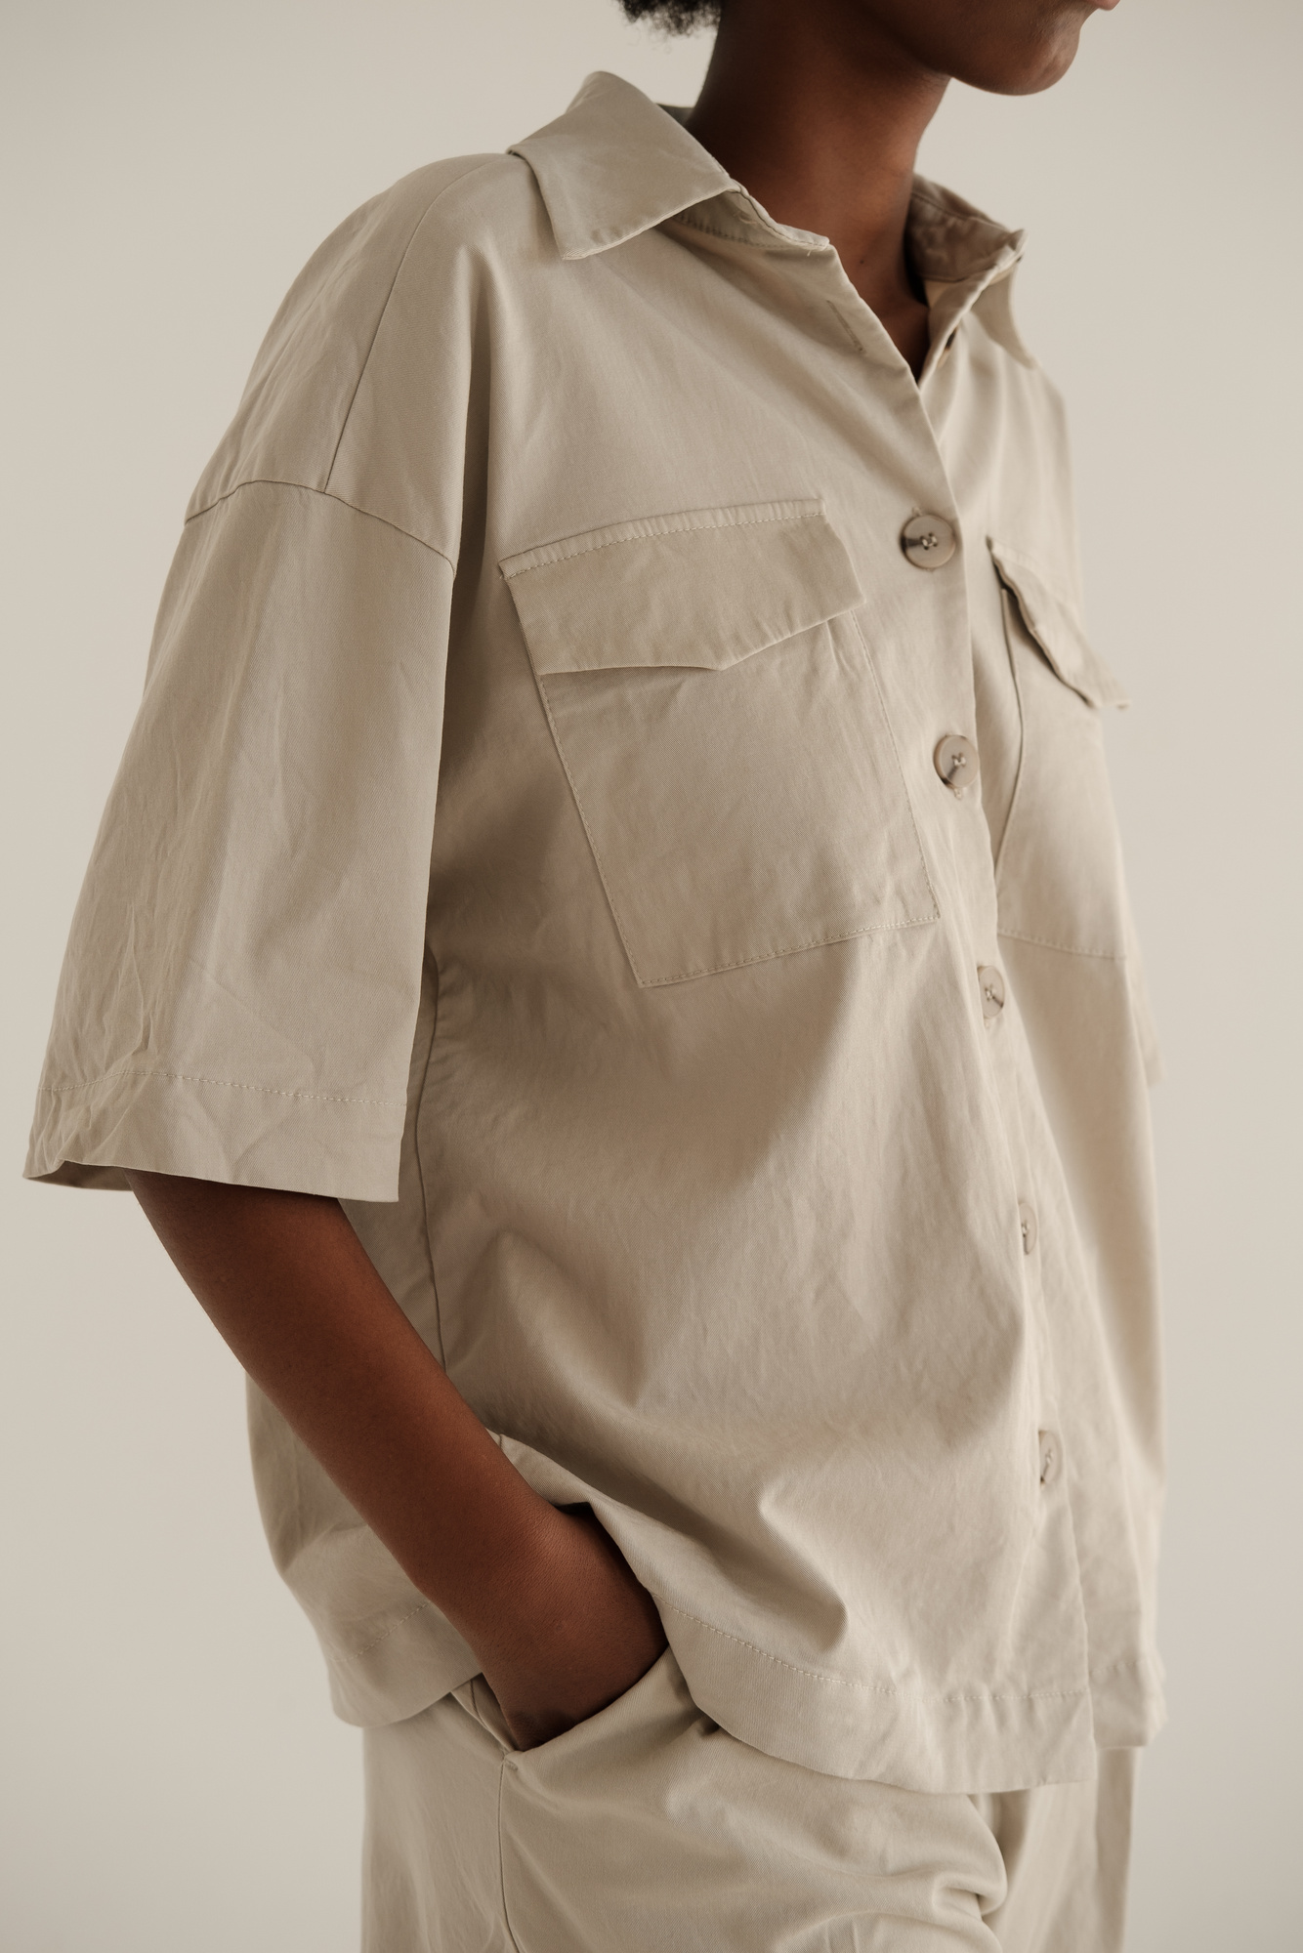
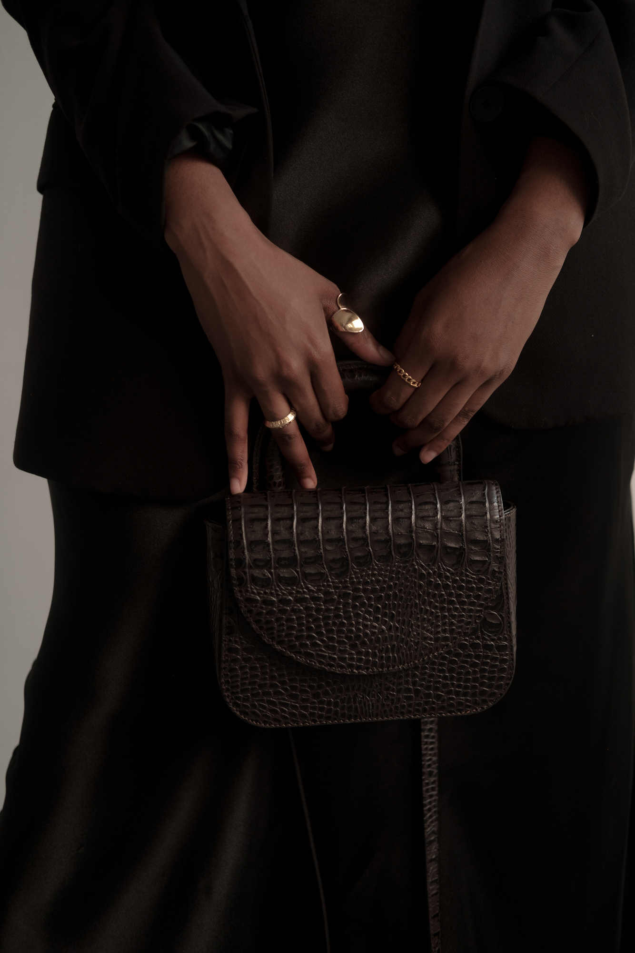
Page 04
Home Page
Display all the items that the user uploaded (specific for each unique userID)
Filter through the category
Click to select to add to saved outfit
Saved outfit page
displaying the saved outfit, an option to save the image to their device
generated using the GD library on PHP to put all the items into a human body template
ABOUT
CONT.

Slide 5
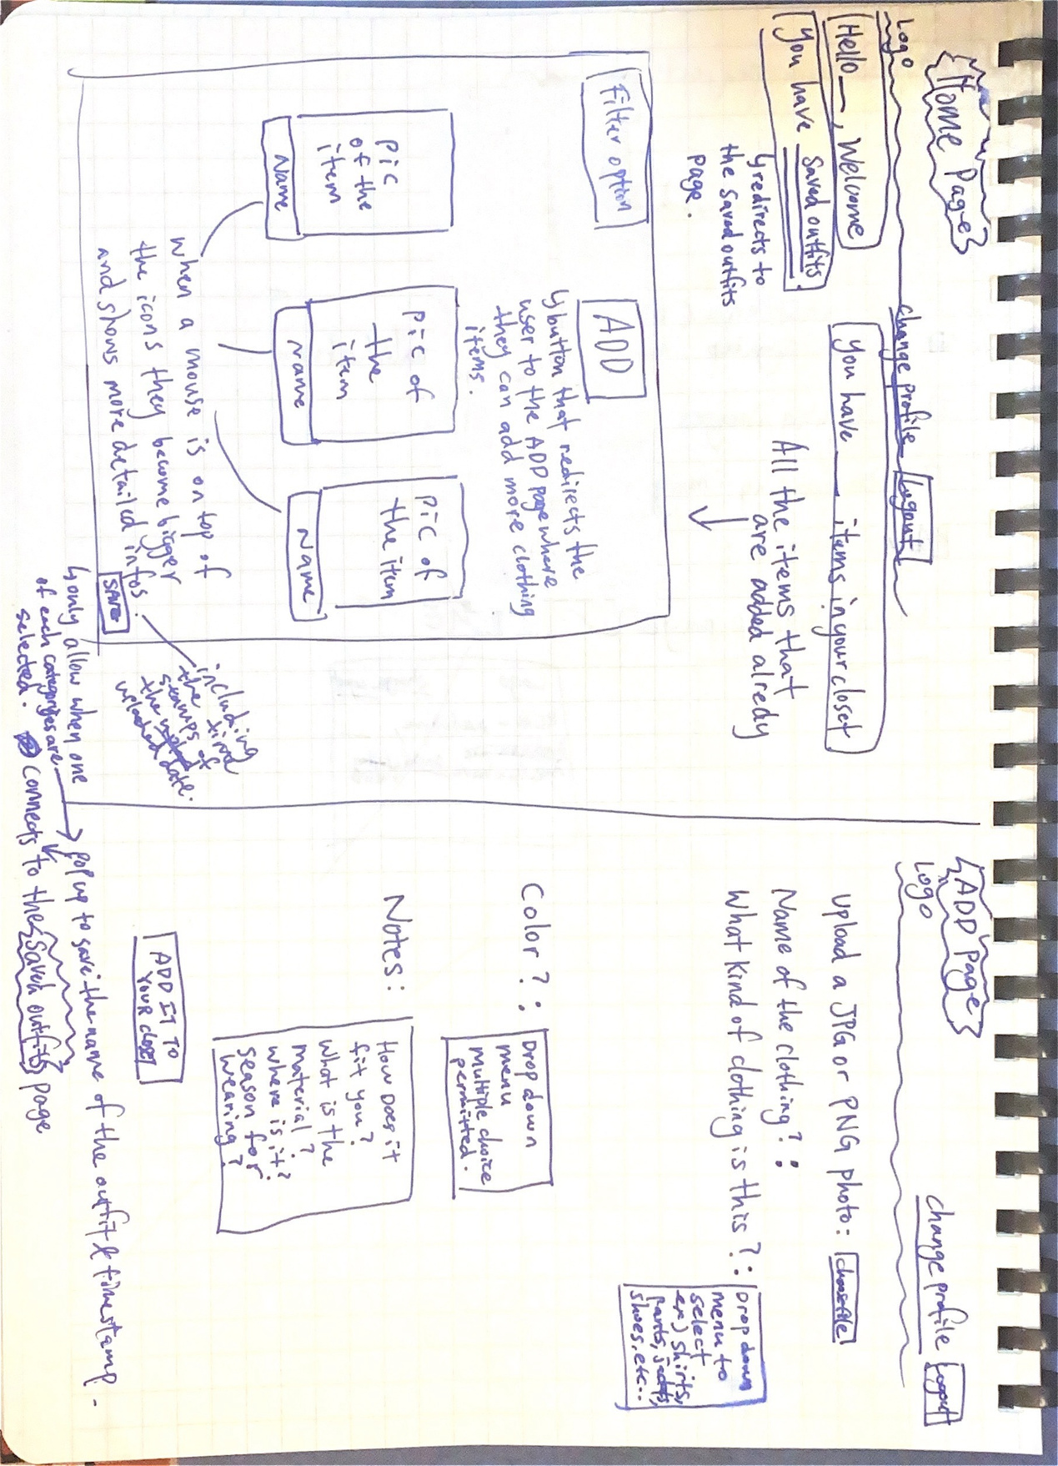
Page 05
@sundaestroll (github)

Slide 6
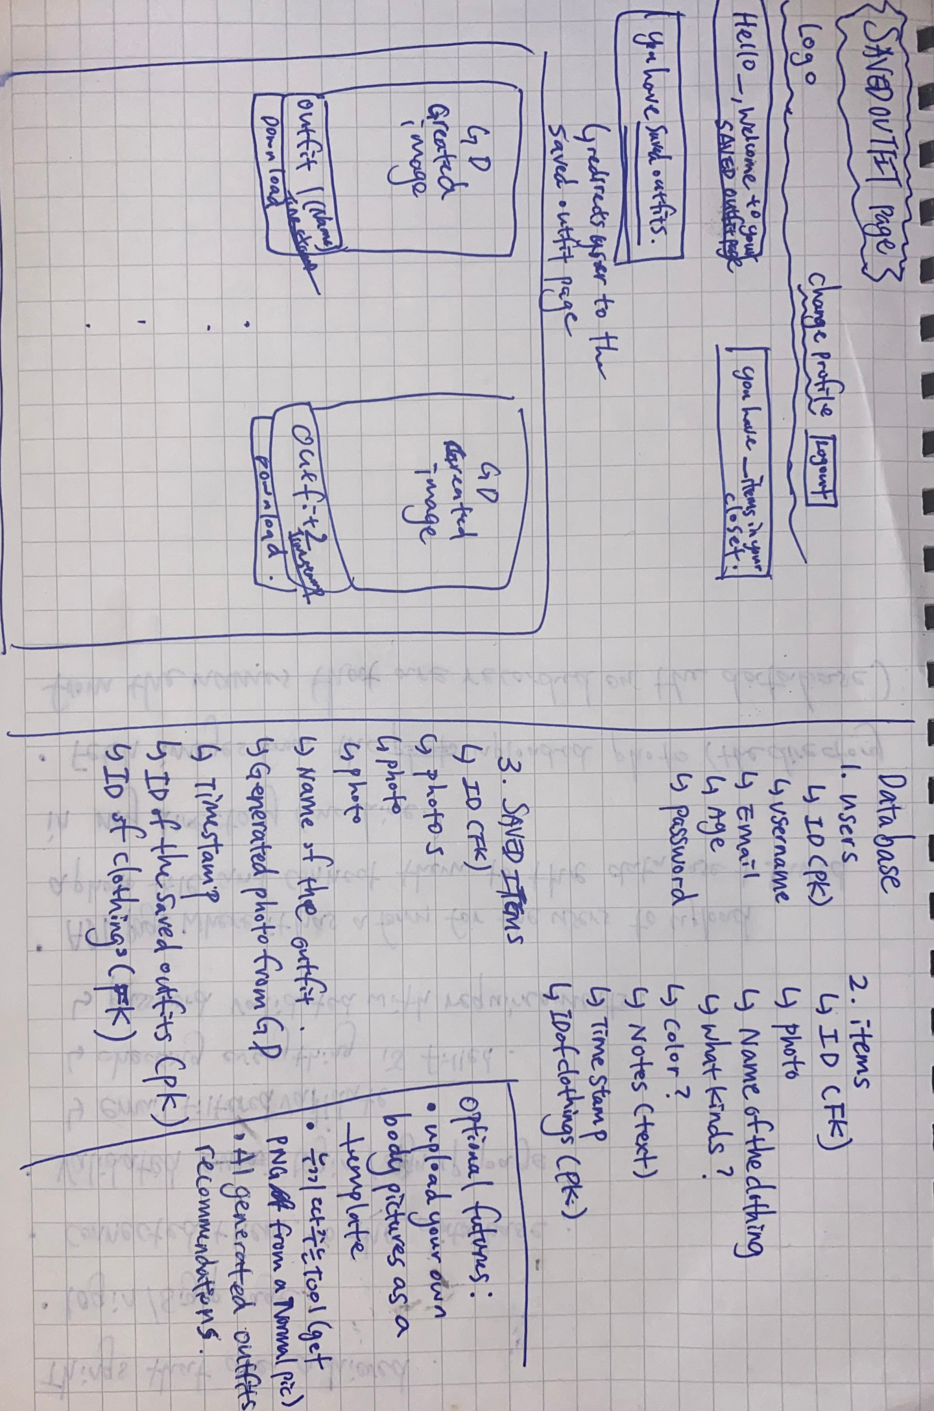
Page 06
@sundaestroll (github)

Slide 7
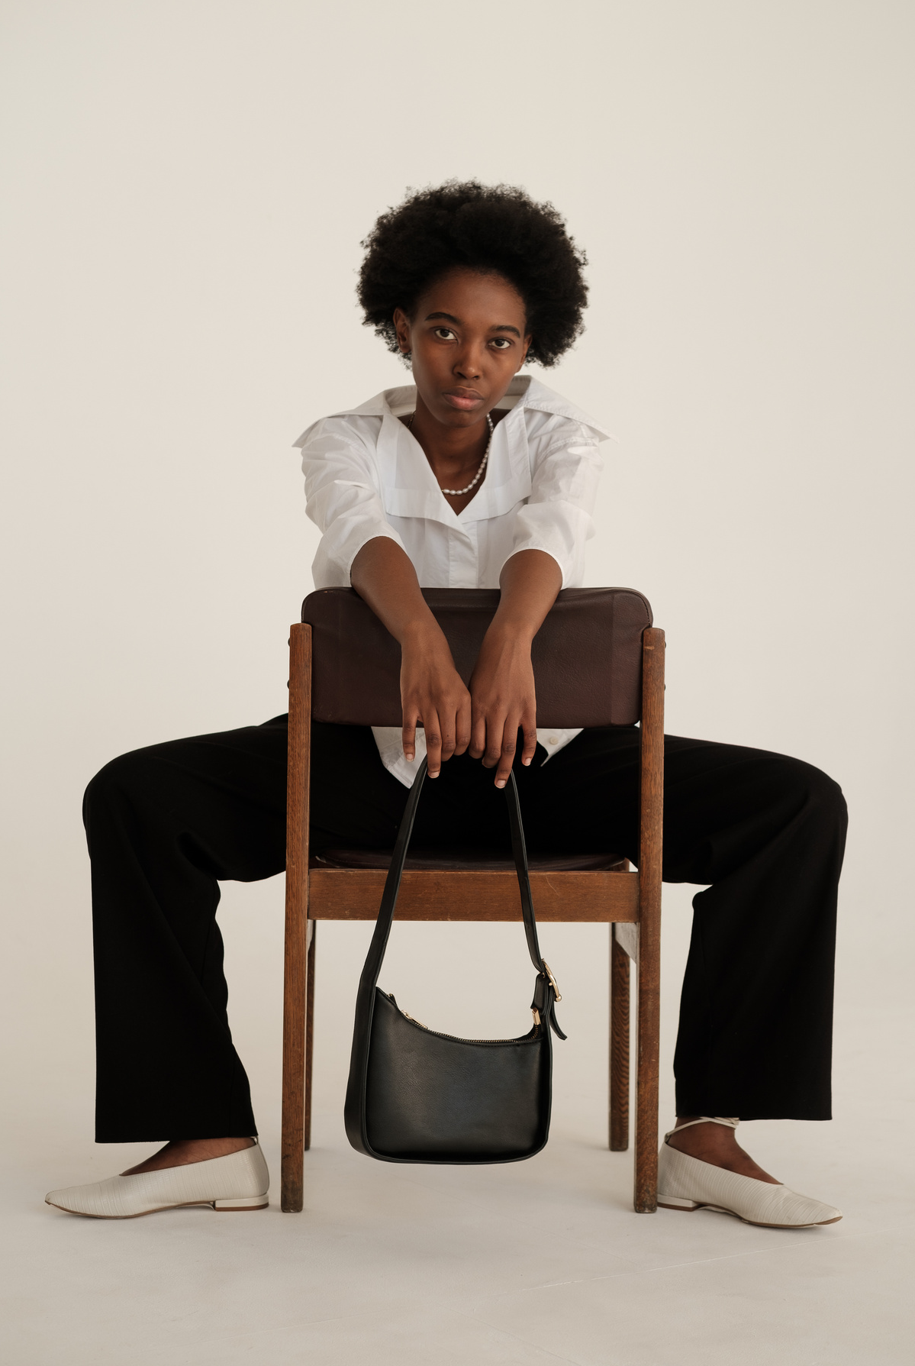
WHAT’S COMPLETED
Page 07
Sign-in and Sign-up page
email and password validation with requirements
checking every field is filled up
Home page
Displaying the added items that are saved in the database (local folder) including heic photos by using “tifig”
ADD button connecting to the ADD page
Add page
working form to take in photo files from the user and successfully connect to the database
converting “HEIC” file extension that is uploaded to “PNG” using the open source code from “tifig”
@sundaestroll (github)

Slide 8
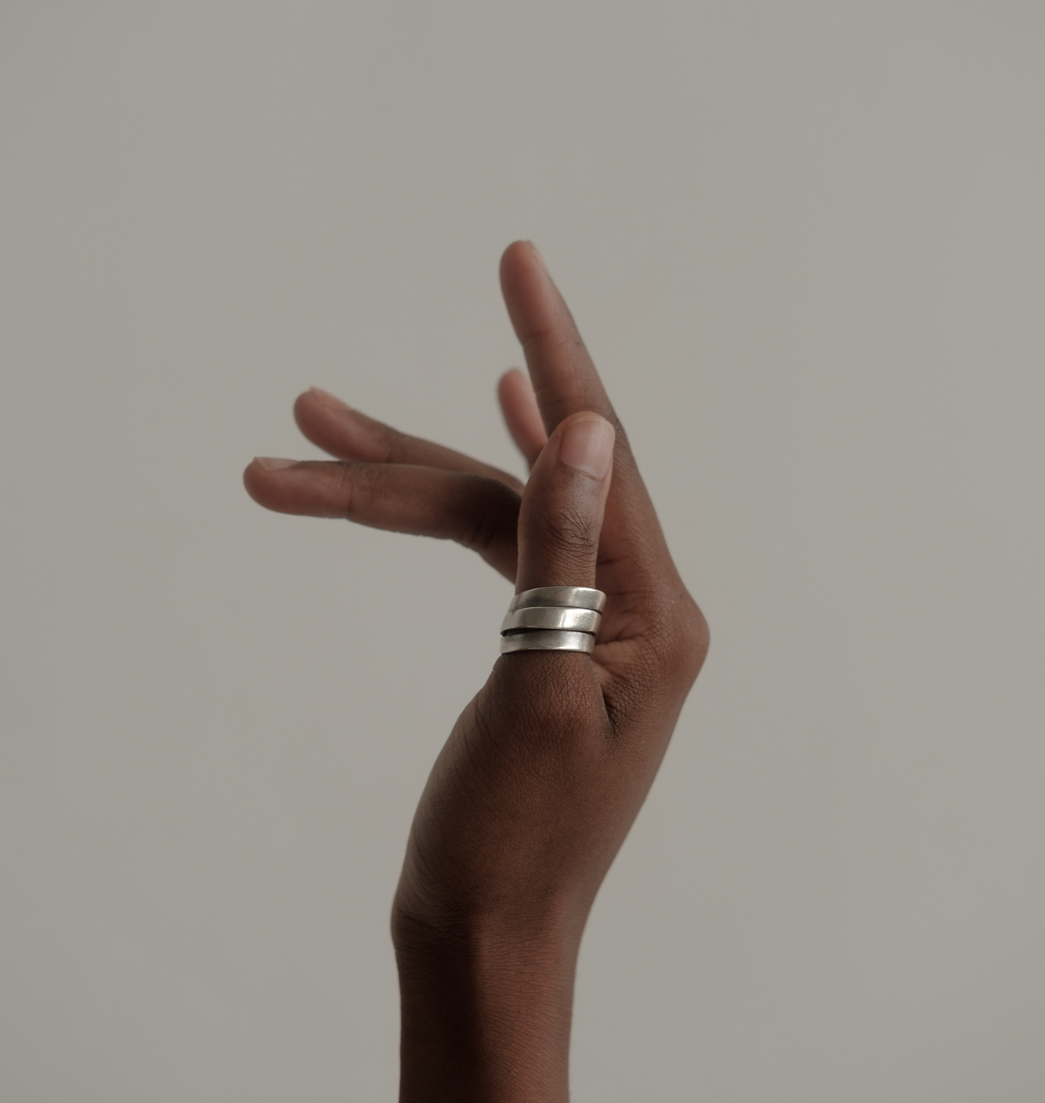
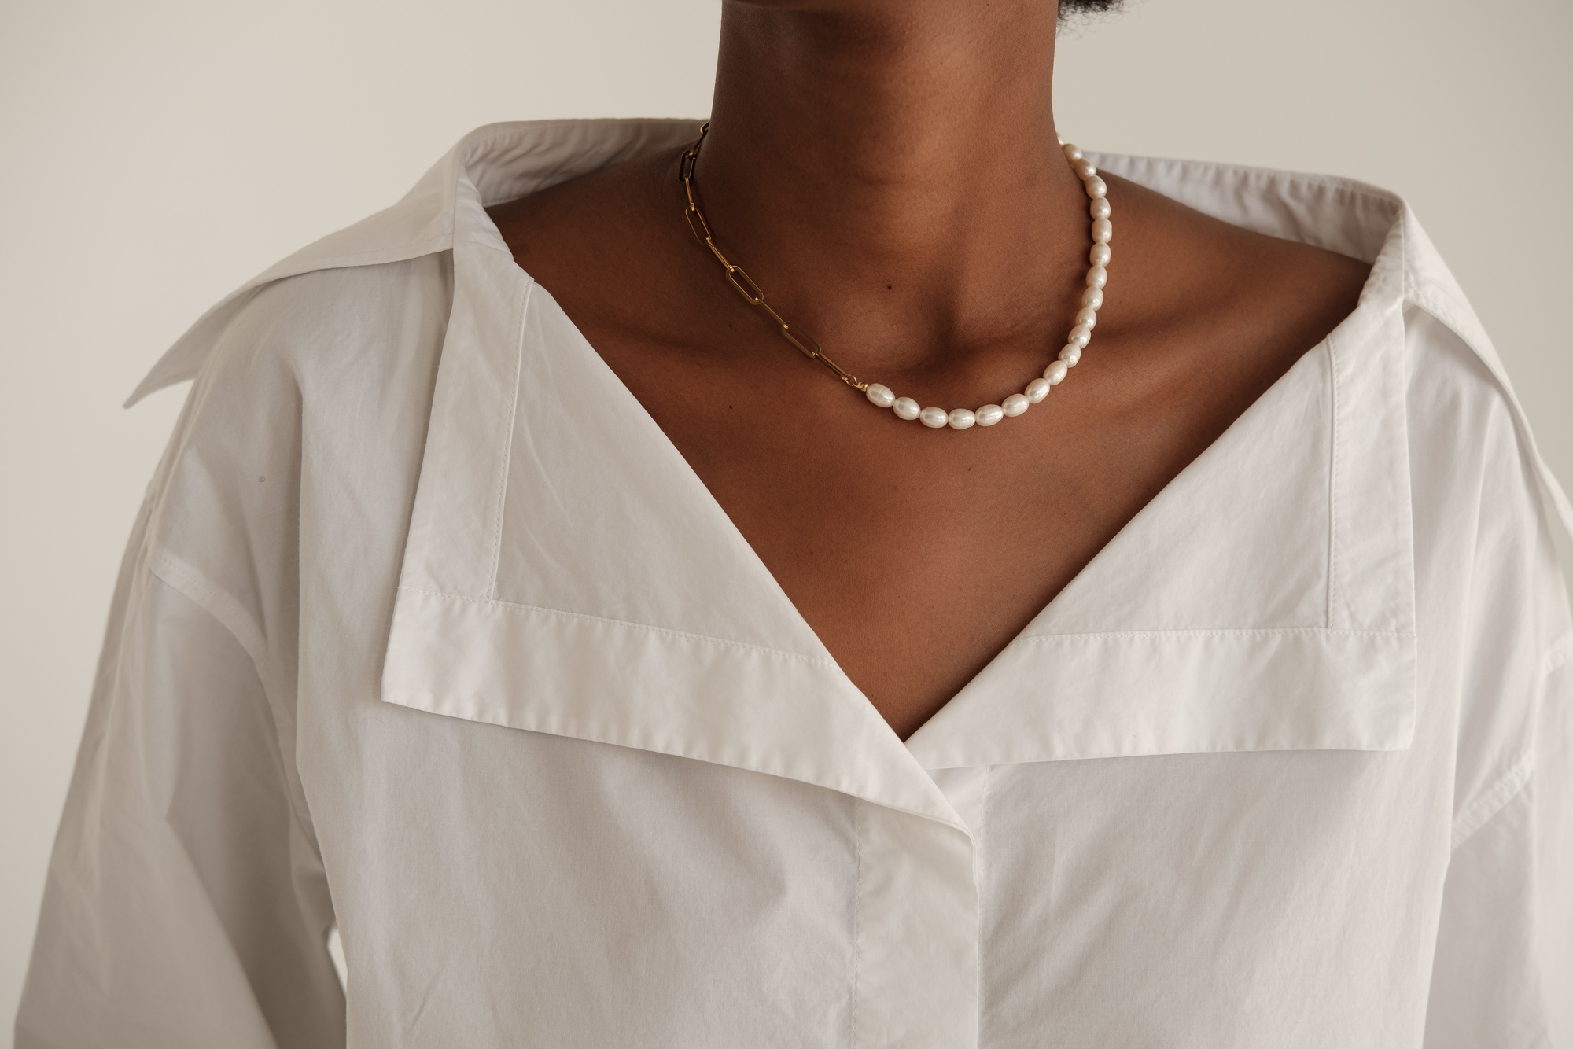
WHAT NEEDS TO BE DONE
/NEXT STEP FOR THE FINAL PROJECT
Page 08
Outfit page
Add page
Saving feature to the outfit database on the Add page
Filter option
Implement the web app to a React native app If possible
Outfit page

Slide 9
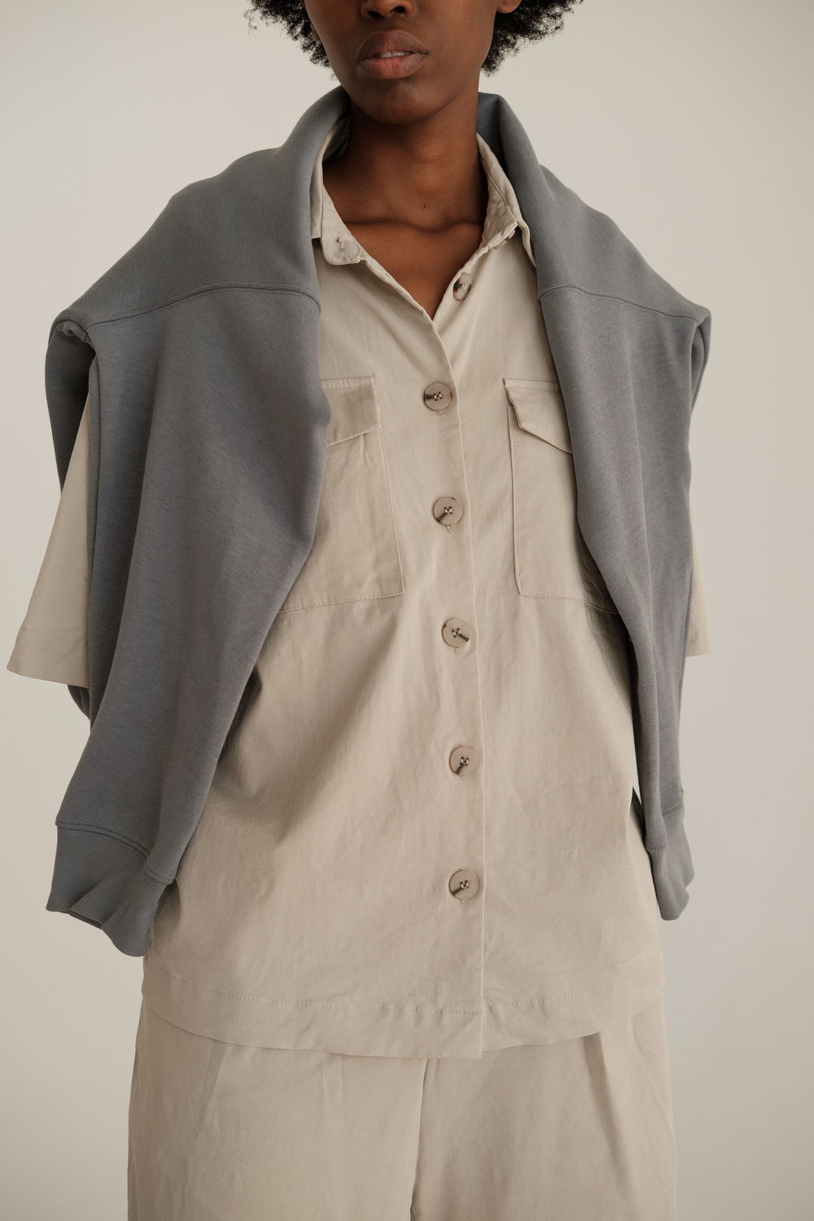
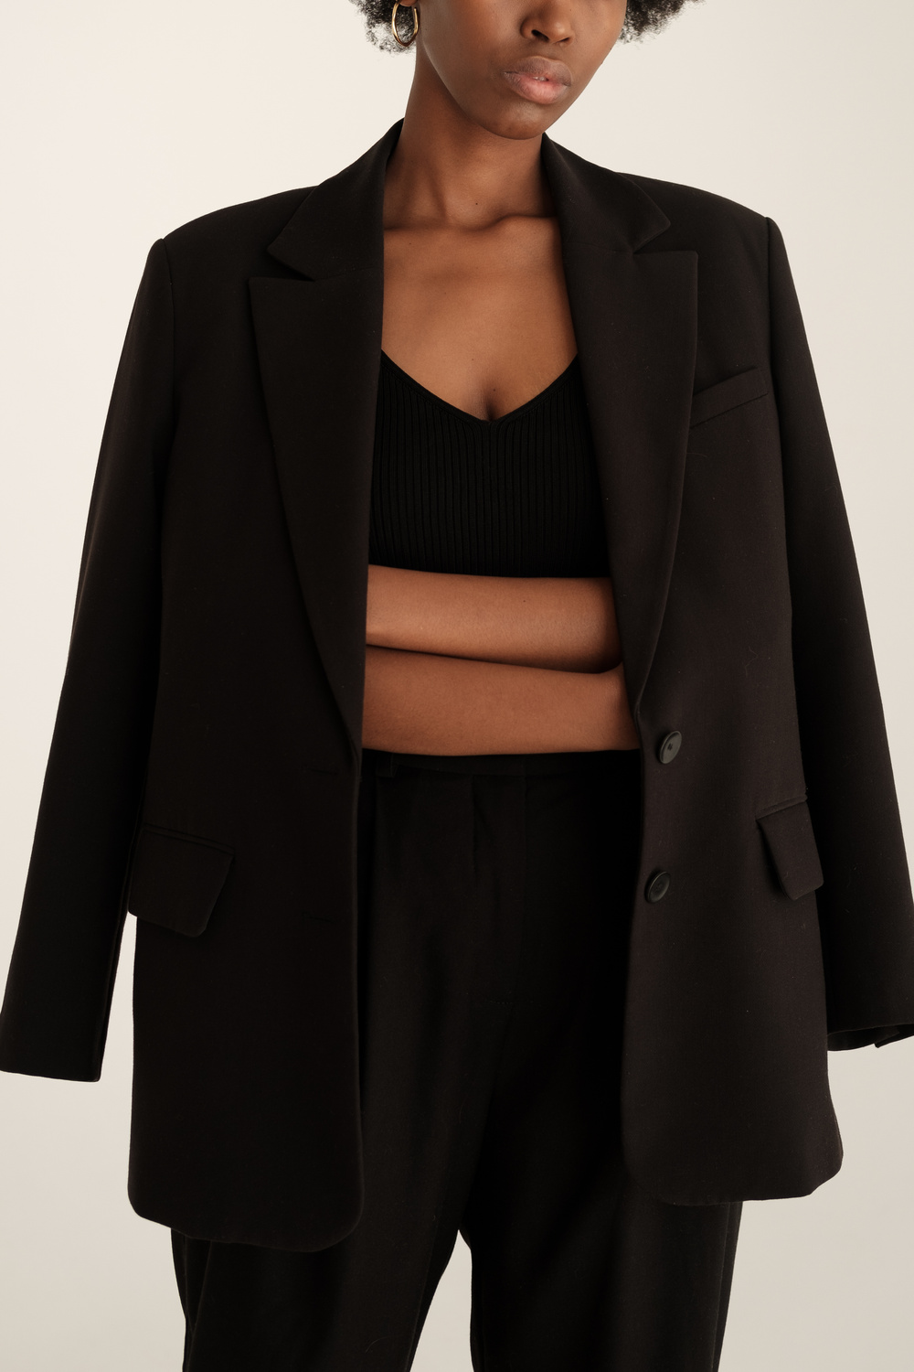
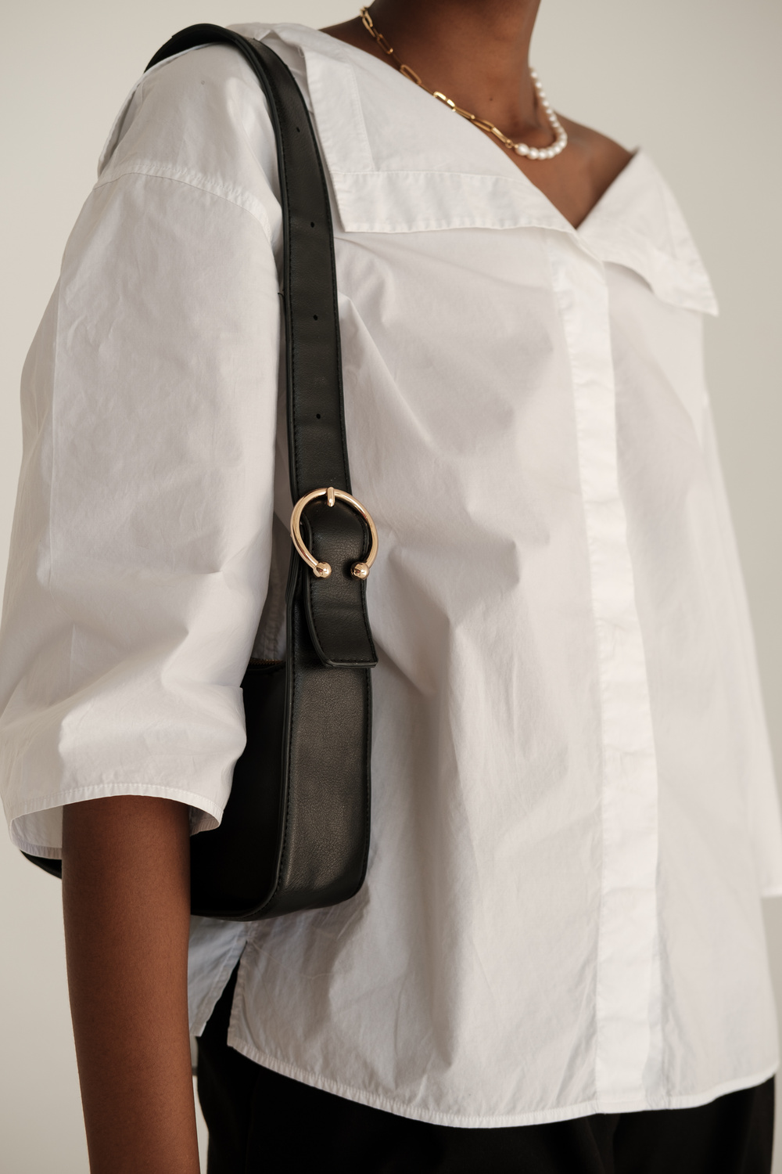
ADITIONAL FEATURES
Page 09
Upload your own unique body type photo to customize the body template
A tool that automatically removes the background of the item photo file (PNG)
AI-generated outfit recommendations

Slide 10
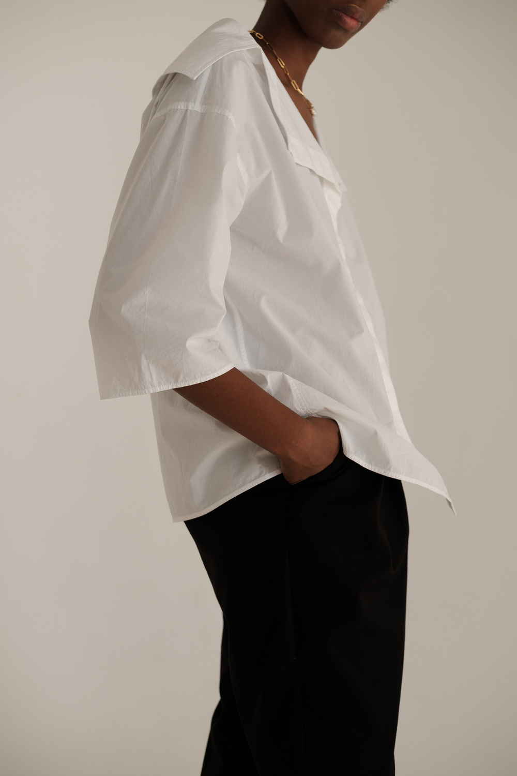
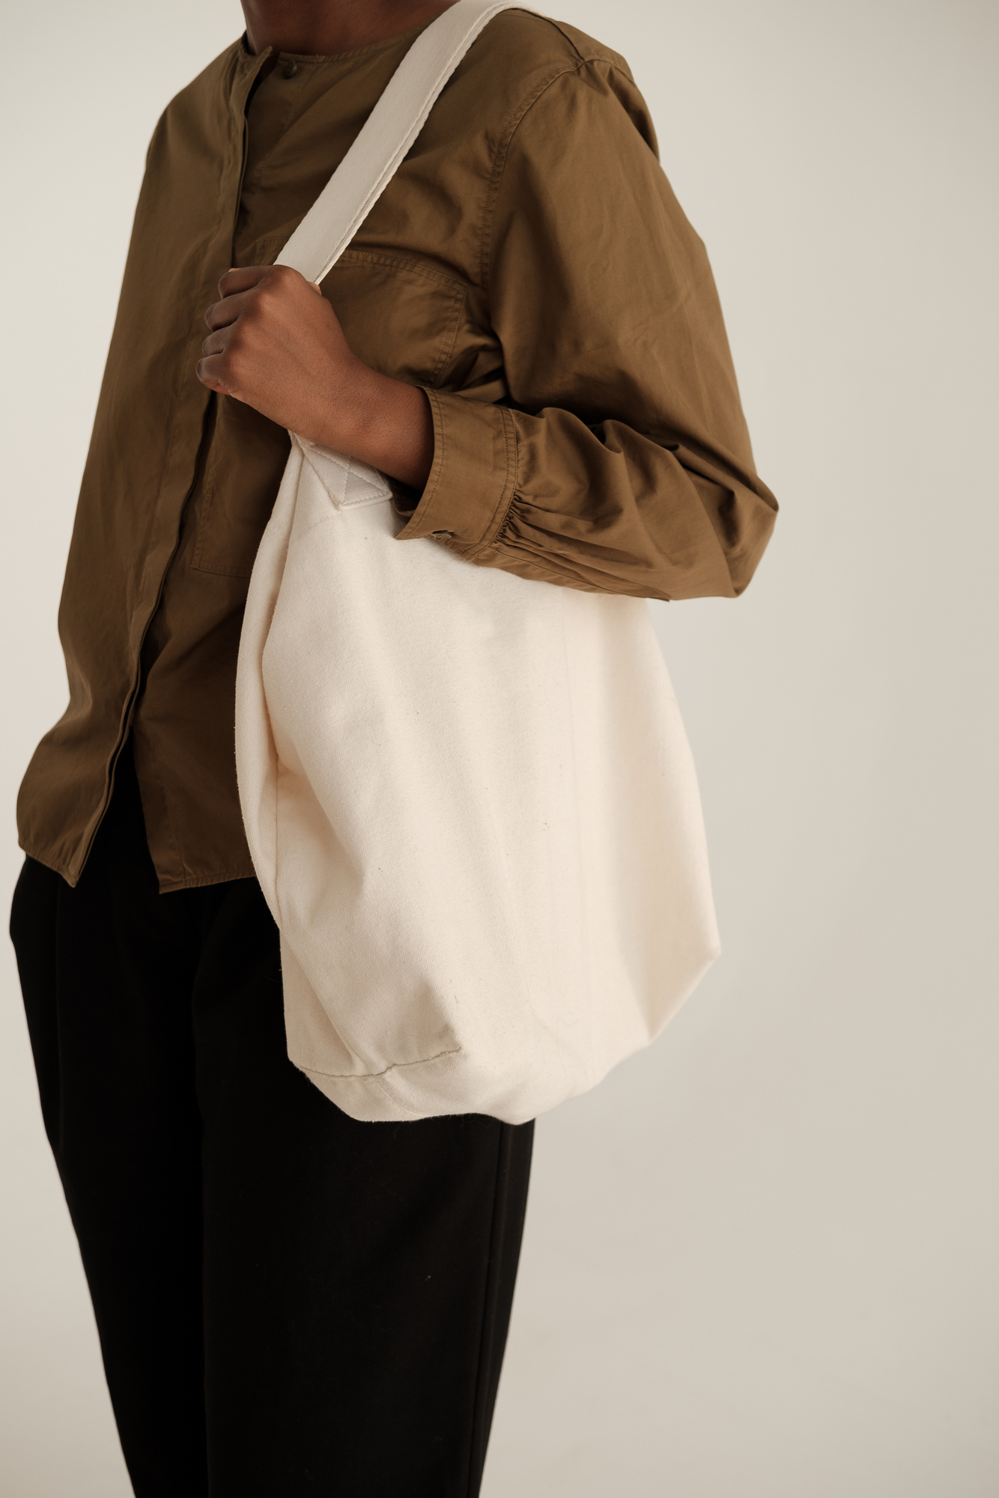
FITCHEK
Page 10
VISIT MY GITHUB
https://github.com/sundaestroll/fitCheck/wiki

Slide 11
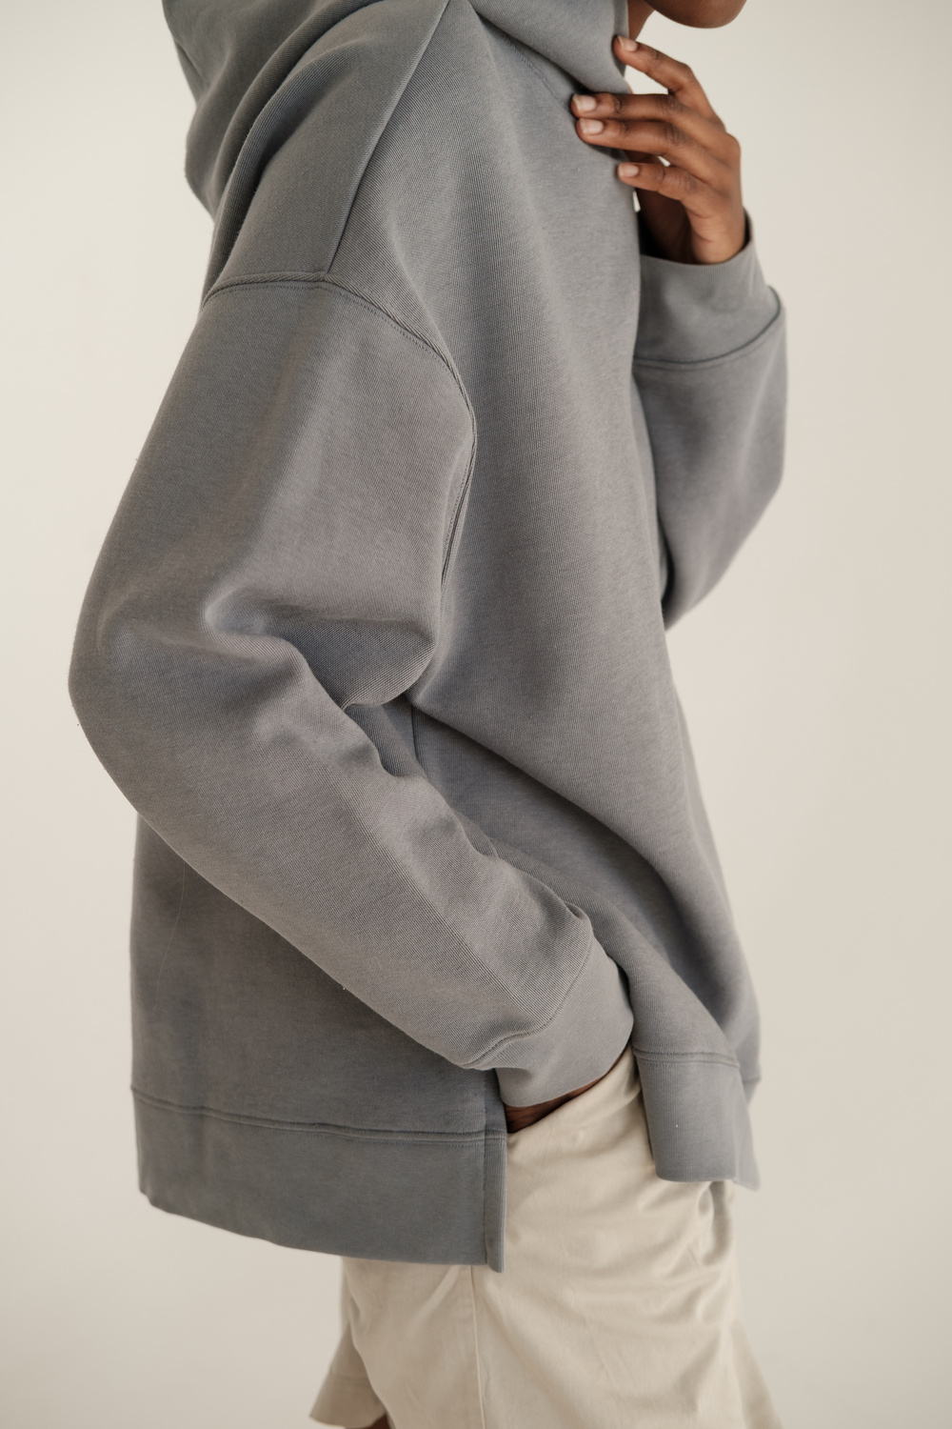
FITCHECK
THANK YOU
@sundaestrol(github)

